Slide 1


KICKAAS
KICK AS A SERVICE
Johannes Bekele, Saniya Bhambhvani, Javier Esteban de Celis, Vamsi Garghi, Yuanfei He, and Shreya Rana

Slide 2

TABLE OF CONTENTS
Our Team
Our Project
Previous Features
New Features
Demo
Testing

Slide 3

OUR TEAM
OUR TEAM
OUR TEAM
OUR TEAM
OUR TEAM

Slide 4




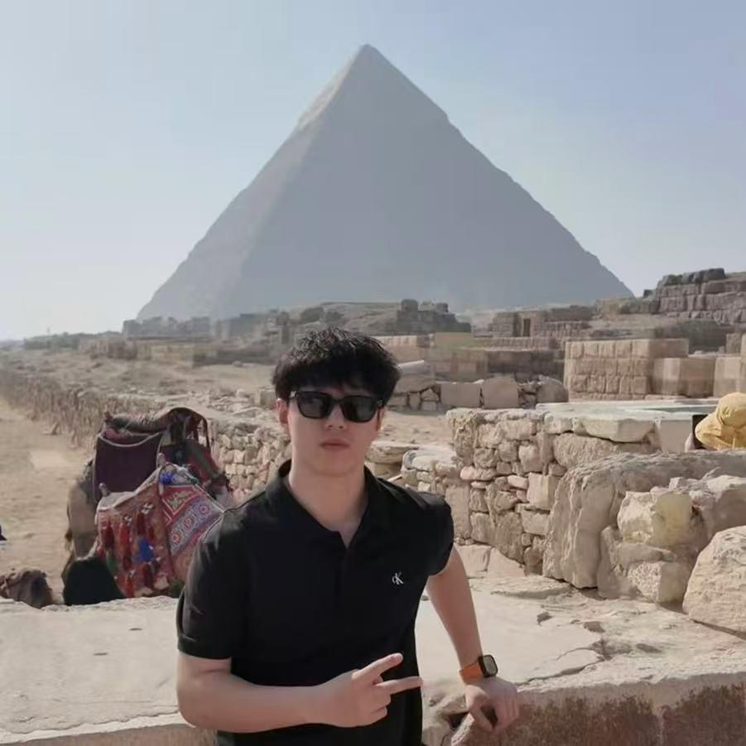


OUR TEAM
Javier Esteban de Celis
Saniya Bhambhvani
Configuration Leader
Team Leader
Vamsi Garghi
Yuanfei He
Requirement Leader
QA Leader
Johannes Bekele
Shreya Rana
Design and Implementation Leader
Security Leader

Slide 5

OUR PROJECT
OUR PROJECT
OUR PROJECT
OUR PROJECT
OUR PROJECT

Slide 6

EVENT MANAGER

Slide 7




EVENT MANAGER
Event Manager is a lightweight, privacy-conscious application that allows users to create and manage various events. It includes many user-friendly features such as:
Event Creation and Management
Ticketing and Registration
Digital Ticket Delivery
Interactive Maps for Discovery

Slide 8

PREVIOUS FEATURES
PREVIOUS FEATURES
PREVIOUS FEATURES
PREVIOUS FEATURES
PREVIOUS FEATURES
PREVIOUS FEATURES

Slide 9


PREVIOUS FEATURES
Landing Page
Header
Create an Event
Events
Sign Up/Sign In
Events Page
Search Bar
Event Card
Sign Up/Sign In
Google via Clerk
Create an Event Form
Event Name
Event Date/Time
Location
Price
Capacity
etc.

Slide 10
NEW FEATURES
NEW FEATURES
NEW FEATURES
NEW FEATURES
NEW FEATURES

Slide 11

USER PROFILE
The User Profile will allow the user to view and edit their account information. In addition, it displays an organized list of all of their events divided into three categories:
Events they are attending
Events they created
Upcoming events

Slide 12

EVENTS FILTER
The Events Filter displays a “Sort” button that provides the user an option to organize the events into several categories such as:
Date
Distance
Price
Capacity
A to Z
Z to A

Slide 13
RSVP
The RSVP feature gives the user a choice to let the host know their attendance status ahead of time. They are allowed to select between:
Going
Maybe
Not going

Slide 14



MAP
The Map feature on the Events page takes the events created and pins them on a map. This enhances the overall experience by being more:
Interactive
Visual
User-Friendly

Slide 15
SECURE BACKEND REST API
Our backend REST APIs require authentication for protected endpoints using a Clerk-issued token. They are then verified using one of the following:
Clerk’s JWKS/verification endpoints
Clerk SDK

Slide 16
DEMO
DEMO
DEMO
DEMO
DEMO

Slide 17
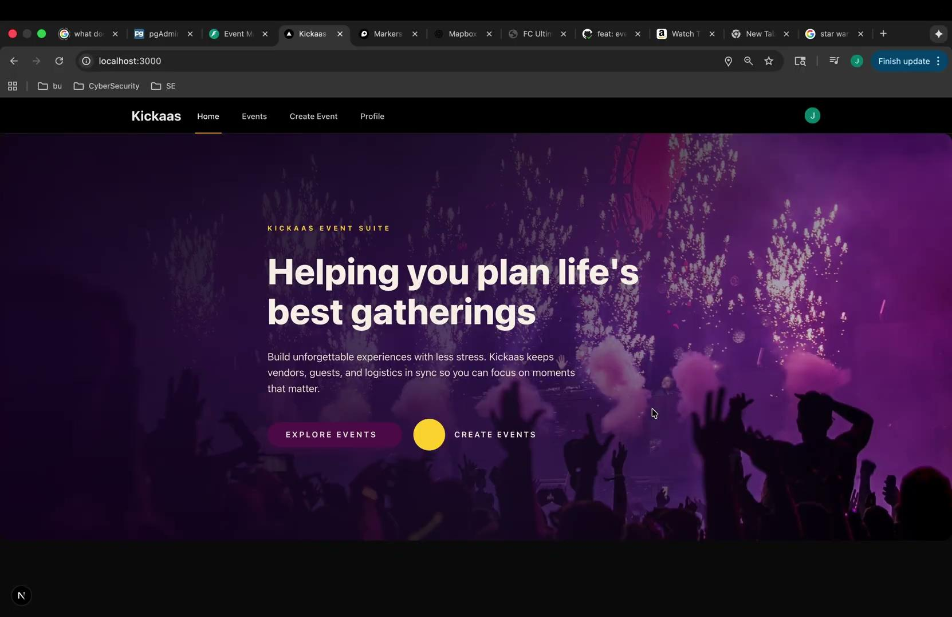

Slide 18
TESTING
TESTING
TESTING
TESTING
TESTING

Slide 19


AUTOMATED TESTING
Backend
Total Tests Executed: 122
Test Result: 100% Pass Rate
Test Execution time: 3.03s
Overall Coverage: 71%
Frontend
Total Tests Executed: 13
Test Result: 100% Pass Rate
Test Run Time: ~3.37s
Overall Coverage (Statements): 83.98%
Branch Coverage: 62.5%
Function Coverage: 68.75%
Line Coverage: 83.98%
Notes:
Automated testing:
Ran using github action during the ci pipeline
When:
Everytime a new pr is created against main
Everytime there is a new push to any remote branch
Where:w
test folders under the code/backend and code/frontend dirs
Why:
Ensure new functionality does not break existing functionality

Slide 20
MANUAL TESTING
Manual Testing involved conducting end-to-end tests for both the frontend (Next.js) and backend (FastAPI) to verify functionality for:
User Registration
Login
Event Creation
Event Listing
Verified frontend and backend integration — Database updates confirmed via PostgreSQL.
Total Tests Executed: 10
Iteration #1: 4 Tests
Iteration #2: 6 Tests
Test Result: 100% Pass Rate
Notes:
Manual testing:
Ran by QA leader
When:
Week iteration is done
Where:
localhosted full stack application
Why:
Ensure end to end functionality

Slide 21
QUESTIONS?
QUESTIONS?
QUESTIONS?
QUESTIONS?
QUESTIONS?

